Slide 1





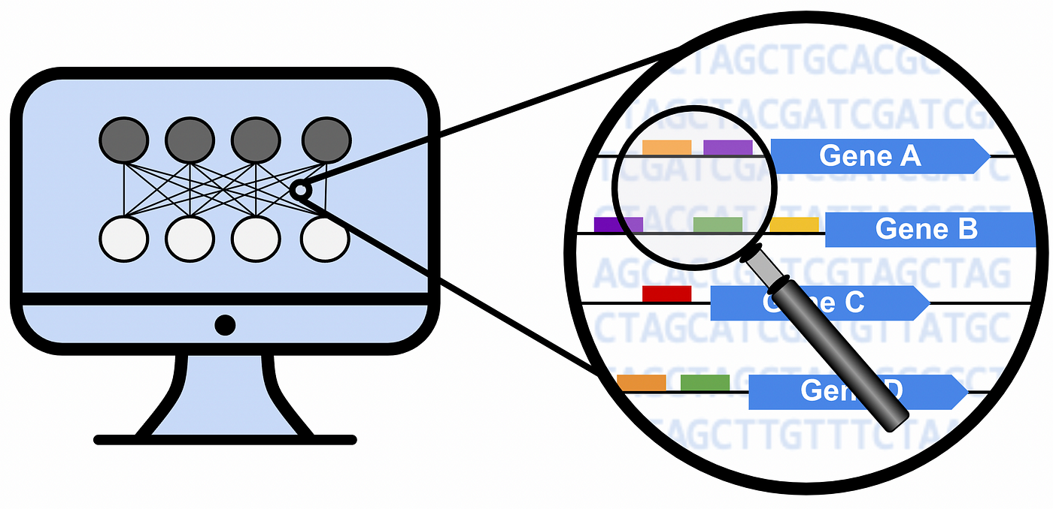
Lung cancer
- Squamous Cell Carcinoma
- 3 stages
Expression dataset
- 15208 genes
- 486 samples
- 45 samples paired/control
Paired samples tumor/control
- log2folchange=log2(Expr(tumor)/Expr(normal))
- threshold log2fc >=0.58
- 2779 genes
Differential analysis
DESeq2
Manually
DESeq2 log2folchange >= 0.58
- Stage I vs. Stages II and III : 13 genes
- Stage II vs. Stages I and III : 7 genes
- Stage III vs. Stages I and II : 71 genes
log2folchange(mean stage i/mean stages ii and III)
- Samples of stage I vs. stages II and III : 201 genes
- Samples of stage II vs. stages I and III : 81 genes
- Samples of stage III vs. stages I and II : 215 genes
Entropy analysis
- entropy per stage
- gene expression per stage
- order of magnitude per stage
- PPI connectivity per stage

Slide 2

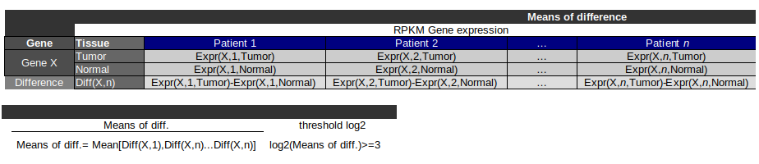
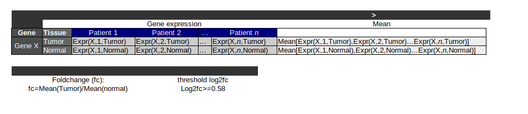
Paired samples tumor/control
Diff. of means
Mean of diff.
- folchange=Avg. Expr(tumor)/Avg. Expr(normal)
- log2folchange >=0.58
- 2779 genes
- folchange=RPKM Expr(tumor)-RPKM Expr(normal)
- Avg(log2folchange) >=3.0
- Stage I : 663 genes
- Stage II : 718 genes
- Stage III : 701 genes

Slide 3
Lung cancer
- Squamous Cell Carcinoma
- 3 stages
Expression dataset
- 15208 genes
- 486 samples
- 45 samples paired/control
Paired samples tumor/control
- log2folchange=log2(Expr(tumor)/Expr(normal))
- threshold log2fc >=0.58
- 2779 genes
Differential analysis
DESeq2
Manually
DESeq2 log2folchange >= 0.58
- Stage I vs. Stages II and III : 13 genes
- Stage II vs. Stages I and III : 7 genes
- Stage III vs. Stages I and II : 71 genes
RPKM log2fc(mean stage i/mean stages ii and III) >= 0.58
- Samples of stage I vs. stages II and III : 201 genes
- Samples of stage II vs. stages I and III : 81 genes
- Samples of stage III vs. stages I and II : 215 genes
Entropy analysis
- entropy per stage
- gene expression per stage
- order of magnitude per stage
- PPI connectivity per stage

